Slide 1

RANDOM
DIMENSIONAL
VOID-VERSE
Notes:
https://unsplash.com/photos/p0j-mE6mGo4

Slide 2
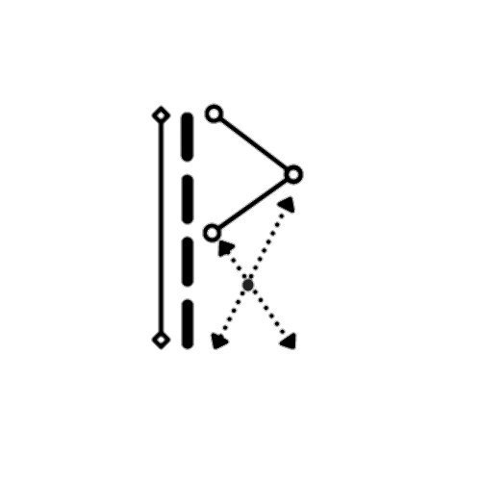
Dev Mehta(19bca029)
Rahul Gosai(19bca013)
Vivek Malam(19bca056)

Slide 3





Content:
Modules in project
Type of Model
Data-Dictionary
Diagrams
Screen-shots

Slide 4
Type of Model
-Spiral Model
Modules in project
Data-Dictionary
Diagrams
Screen-shots
~a risk driven software development process model which
adopts elements of one or more process models, such as
incremental, waterfall, or evolutionary prototyping.

Slide 5

Modules in project
Play Mode
Map Generation
Armory & Abilities
Inventory
Crafting Items
Chat & VoIP
Result Screen
Game Settings
Type of Model
Data-Dictionary
Diagrams
Screen-shots

Slide 6
Diagrams
use-case Diagram
DFD(Context Level, 0 Level)
ER Diagram
Activity Diagram
Type of Model
Data-Dictionary
Modules in project
Screen-shots

Slide 7
Data-Dictionary
Account
Character
Achievements
Quests
Weapons
Abilities
Diagrams
Type of Model
Diagrams
Modules in project
Screen-shots

Slide 8
Screen-shots
Concept Arts
Prototype 1[Procedural Terrain]
Prototype 2[Player Controller]
Prototype 3[Terraforming]
Concept UI & Animations
Networking[Rooms, Chat, VoIP]
Ongoing Dev-Pics
Diagrams
Type of Model
Data-Dictionary
Modules in project

Slide 9
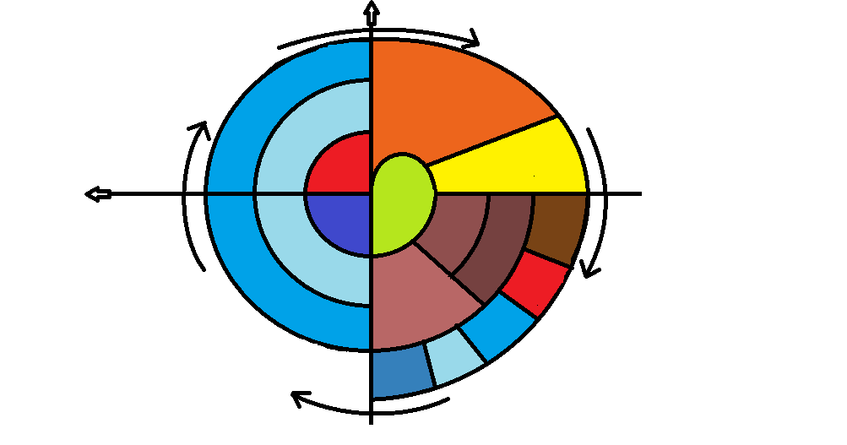
Cumulative Cost
progress
Identify
&
Resolve Risks
Determining
Objectives
Risk Analysis
Require-
ments
plan
Prototype
[1-2-3]
Review
Concept
Of
Require-
ments
Spiral Model
Concept
Of
operation
Detailed
Design
Development
plan
Draft
Verification
&
Validation
Code
Test
plan
Plan the
Next Iteration
Integration
Development
&
Testing
Test
Release
Implemen-
tation

Slide 10
Why we are using Spiral Model:
The spiral model enables gradual releases and refinement of a product through
each phase of the spiral as well as the ability to build prototypes at each phase.
The most important feature of the model is its ability to manage unknown risks
after the project has commenced.
Spiral Model
Also:
The spiral model combines the idea of iterative development with the systematic, controlled aspects of the waterfall model. This Spiral model is a combination of iterative development process model and sequential linear development model i.e. the waterfall model with a very high emphasis on risk analysis. It allows incremental releases of the product or incremental refinement through each iteration around the spiral.

Slide 11
Benefits of using Spiral Model:
Flexibility - Changes made to the requirements after development has started can be easily adopted and incorporated.
Risk handling - The spiral model involves risk analysis and handling in every phase, improving security and the chances of avoiding attacks and breakages. The iterative development process also facilitates risk management.
Customer satisfaction - The spiral model facilitates customer feedback. If the software is being designed for a customer, then the customer will be able to see and evaluate their product in every phase. This allows them to voice dissatisfactions or make changes before the product is fully built, saving the development team time and money.
Spiral Model

Slide 12
Limitations of using Spiral Model:
High cost - The spiral model is expensive and, therefore, is not suitable for small projects.
Dependence on risk analysis - Since successful completion of the project depends on effective risk handling, then it is necessary for involved personnel to have expertise in risk assessment.
Complexity - The spiral model is more complex than other SDLC options. For it to operate efficiently, protocols must be followed closely. Furthermore, there is increased documentation since the model involves intermediate phases.
Hard to manage time - Going into the project, the number of required phases is often unknown, making time management almost impossible. Therefore, there is always a risk for falling behind schedule or going over budget.
Spiral Model

Slide 13
Play Mode:
There are 3 different type of modes.
Adventure
Survival
Battle Royale
Modules in project
Map Generation:
A procedural generated random map having group of chunks with LOD and each chunk has its own seed.
User can spawn in this map by entering the seed into the game.

Slide 14
Armory & Abilities:
There are armory such as different types of guns & melee weapons.
And there are 20+ abilities like healing, less damage, speed movement etc.
These armory are managed under the Inventory.
Modules in project
Inventory:
The inventory is the pop-up menu that the player uses to manage items they carry. From this screen a player can equip weapons, craft items on a 2×2 grid, and equip tools & collectible items.

Slide 15
Crafting Items:
In Survival Mode :
We can craft items by using 2 or more collectables items and build items to survive in the game.
Example:
ROCK + WOOD = AXE
Modules in project
Chat & VoIP:
After joining the rooms(Servers) player can communicate via chat system &
VoIP(voice chat).
As we are using Photon Network which includes:
Chat
VoIP
Creating/Leaving Rooms
Ownership transfer
Game state management
Spawn management
Match Making
RPC & Friend List

Slide 16
Result Screen:
It displays the scoreboard, leaderboard, achievements, match stats & detailed report on the player’s most used weapons/abilities.
It also shows the K/D ratio and total kills per career with completed side Quests.
Game Settings:
Modules in project
Game settings such as graphic settings, customize key bindings, select abilities into slots, audio settings, report player, select crosshair select loadouts, view match details, resolution

Slide 17
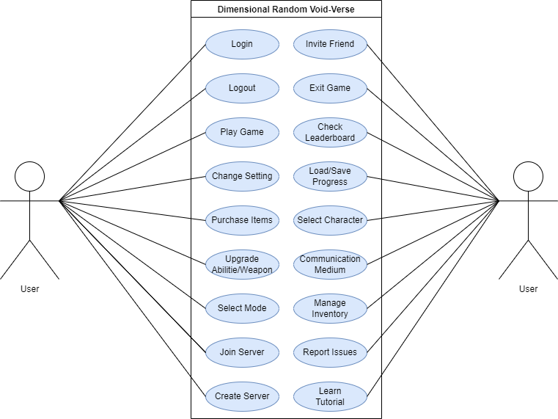
use-Case Diagram:
Diagrams

Slide 18
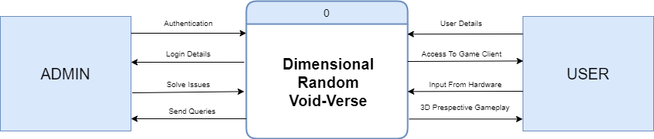
Data Flow Diagram:
Context Level :-
Diagrams

Slide 19
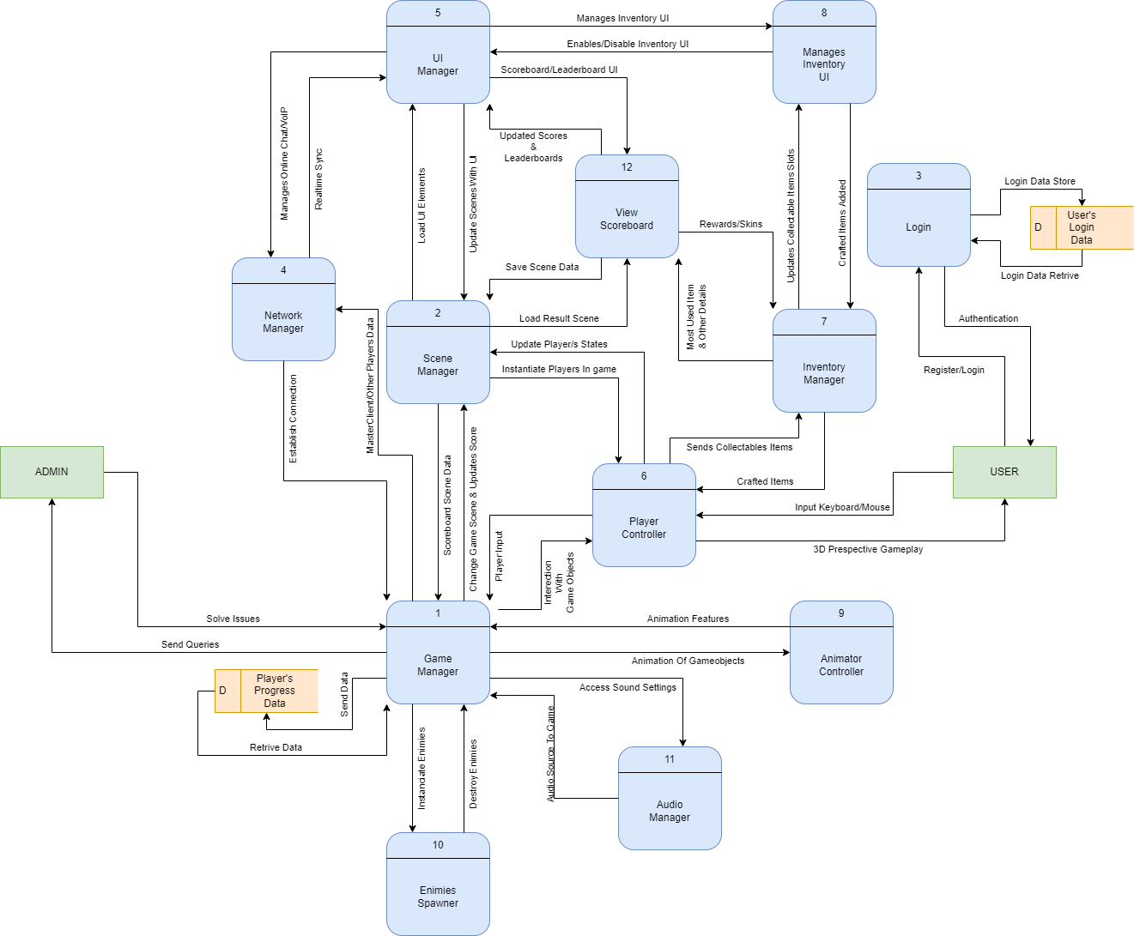
DFD
Level 0 :-
Diagrams

Slide 20
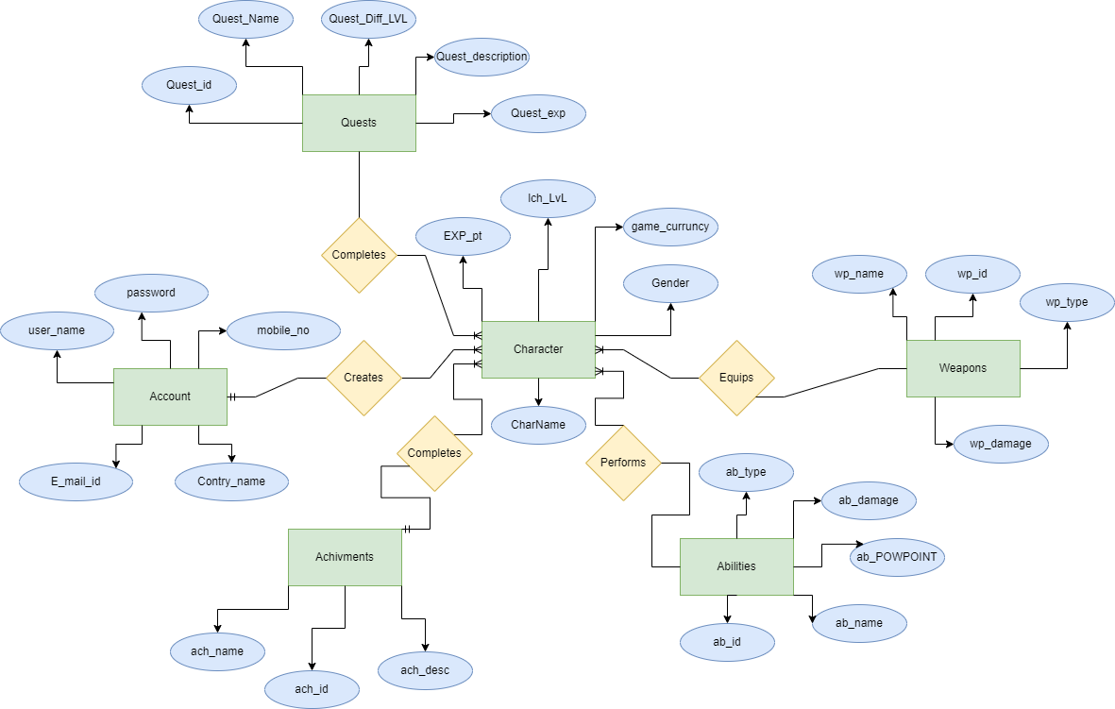
ER Diagram:
Diagrams

Slide 21
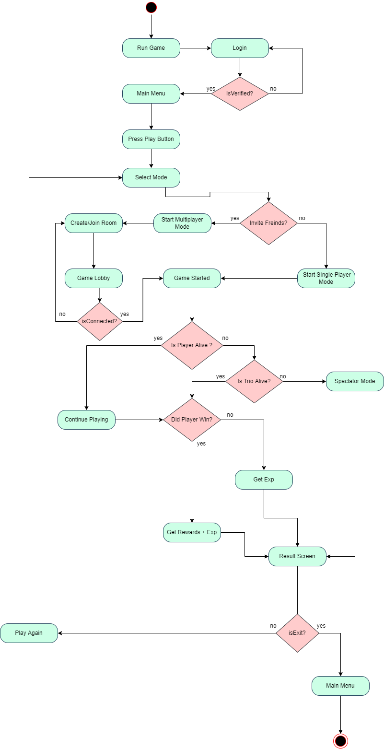
Activity Diagram:
Game :-
Diagrams

Slide 22
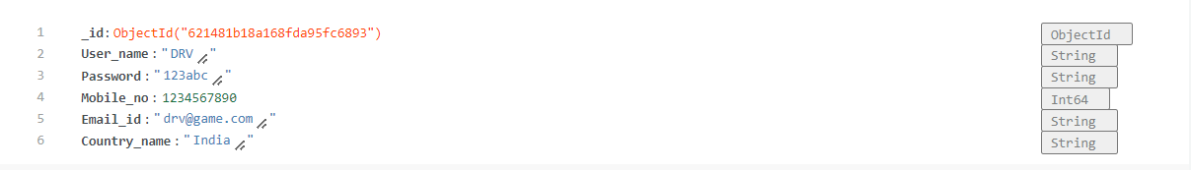
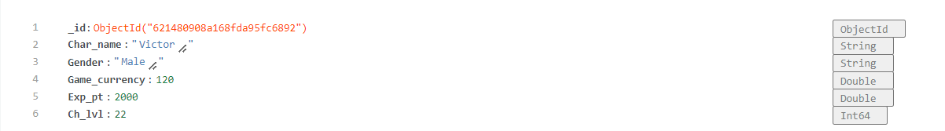
Account:
Data-Dictionary
Character:

Slide 23
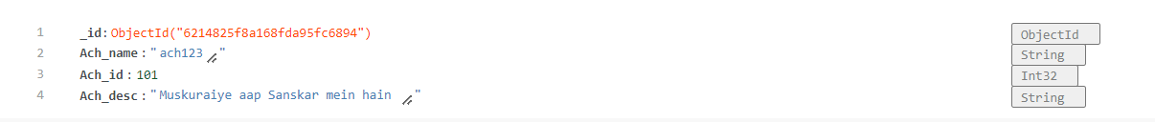
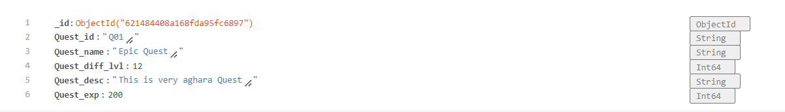
Achievement:
Data-Dictionary
Quest:

Slide 24
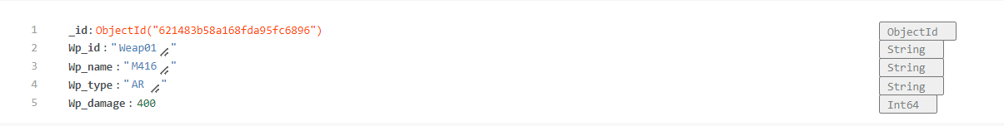
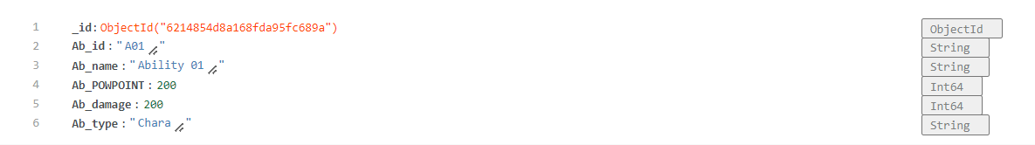
Weapon:
Data-Dictionary
Abilities:

Slide 25
Concept Art
Screen-shots

Slide 26
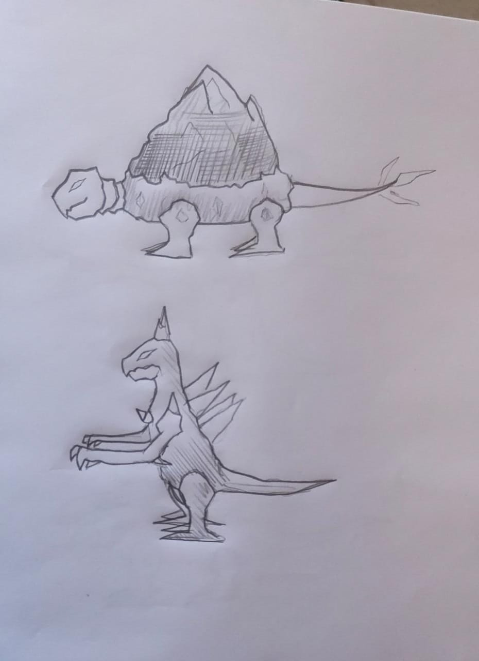

Slide 28
Prototype 1[Procedural Terrain]
Screen-shots

Slide 29
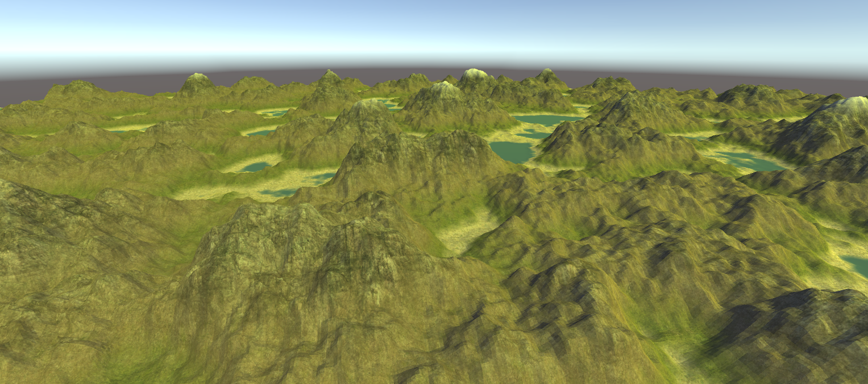

Slide 30
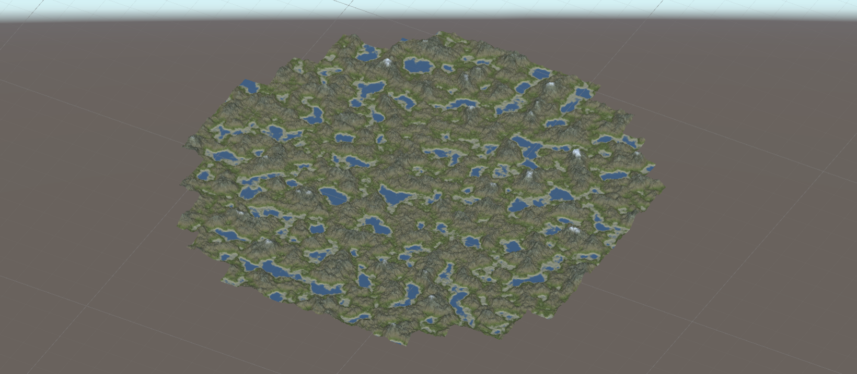

Slide 31
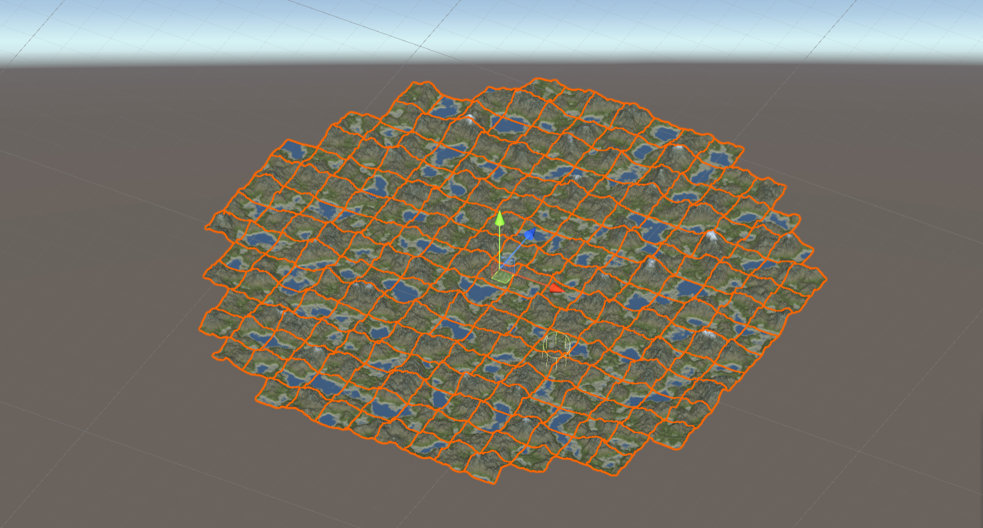

Slide 32
Prototype 2[Player Controller]
Screen-shots

Slide 33
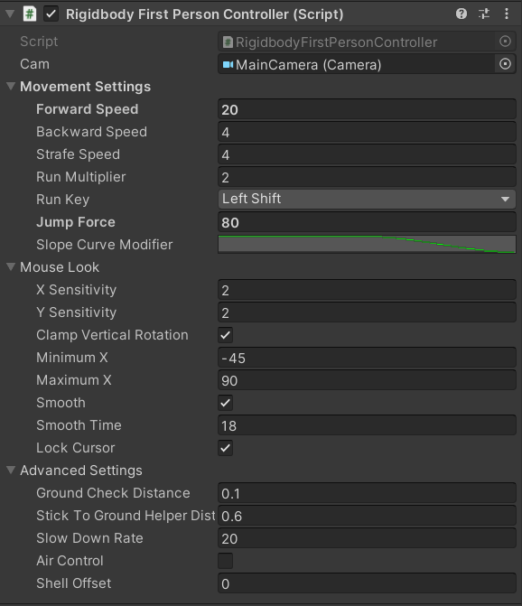
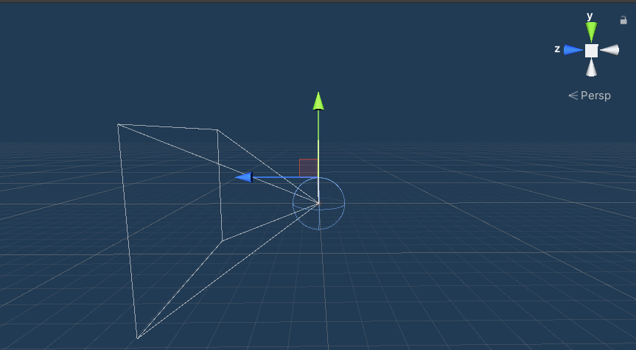
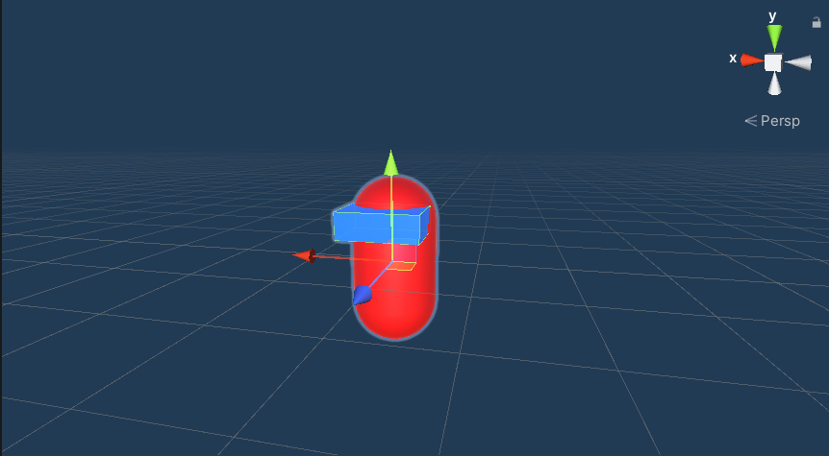

Slide 34
Prototype 3[Terraforming]
Screen-shots

Slide 35
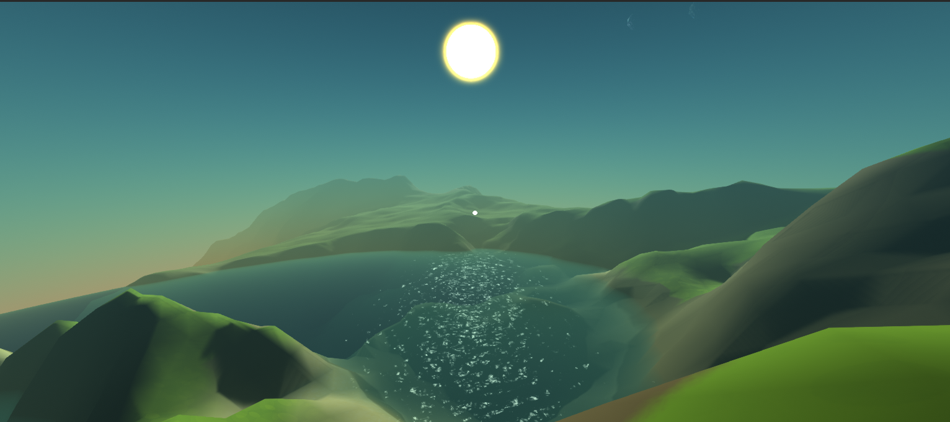

Slide 36
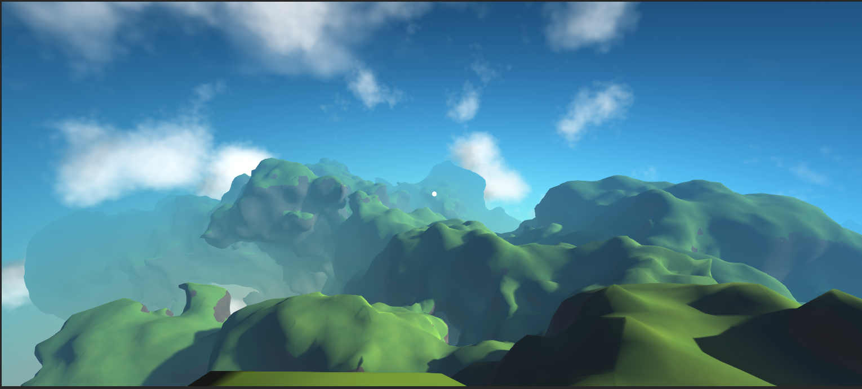

Slide 37
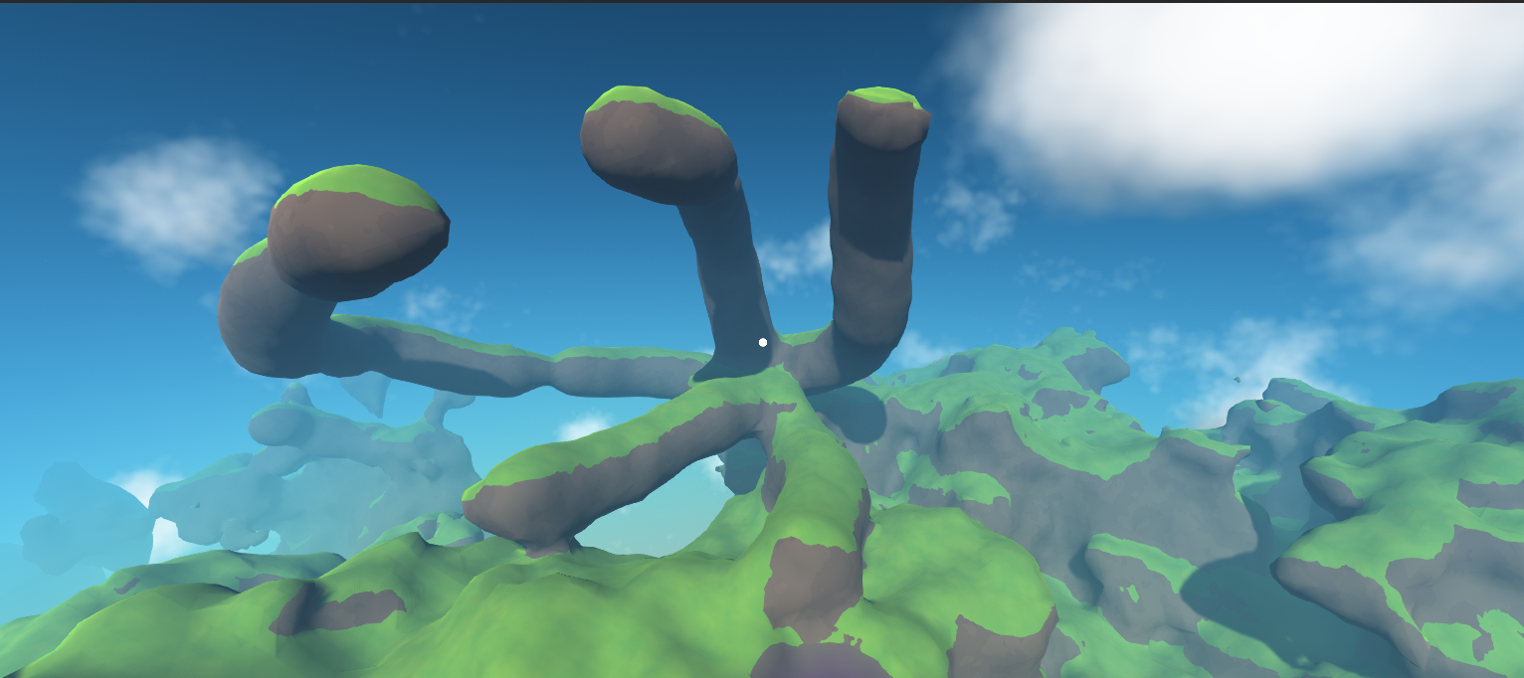

Slide 38
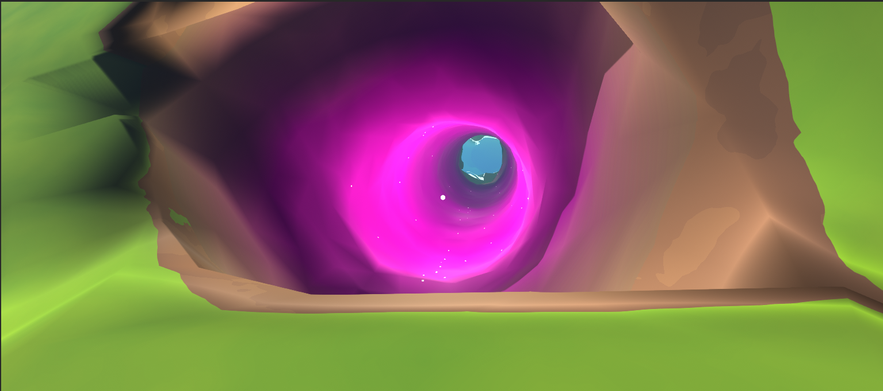

Slide 39
Concept UI & Animations
Screen-shots

Slide 40
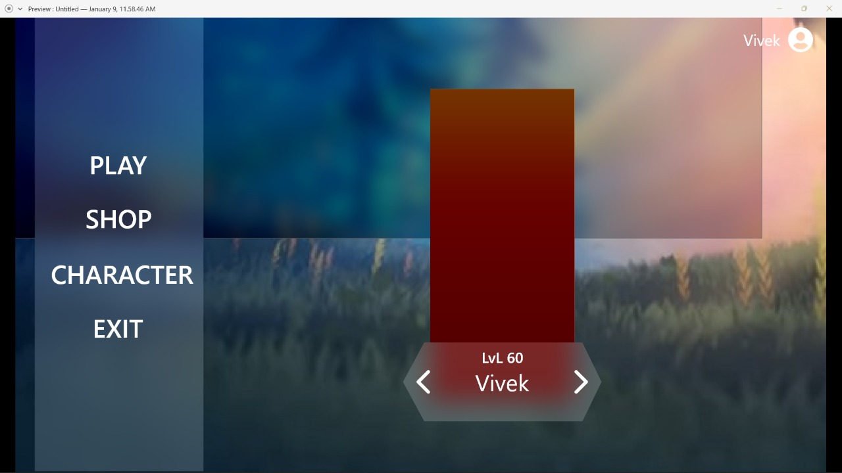

Slide 41
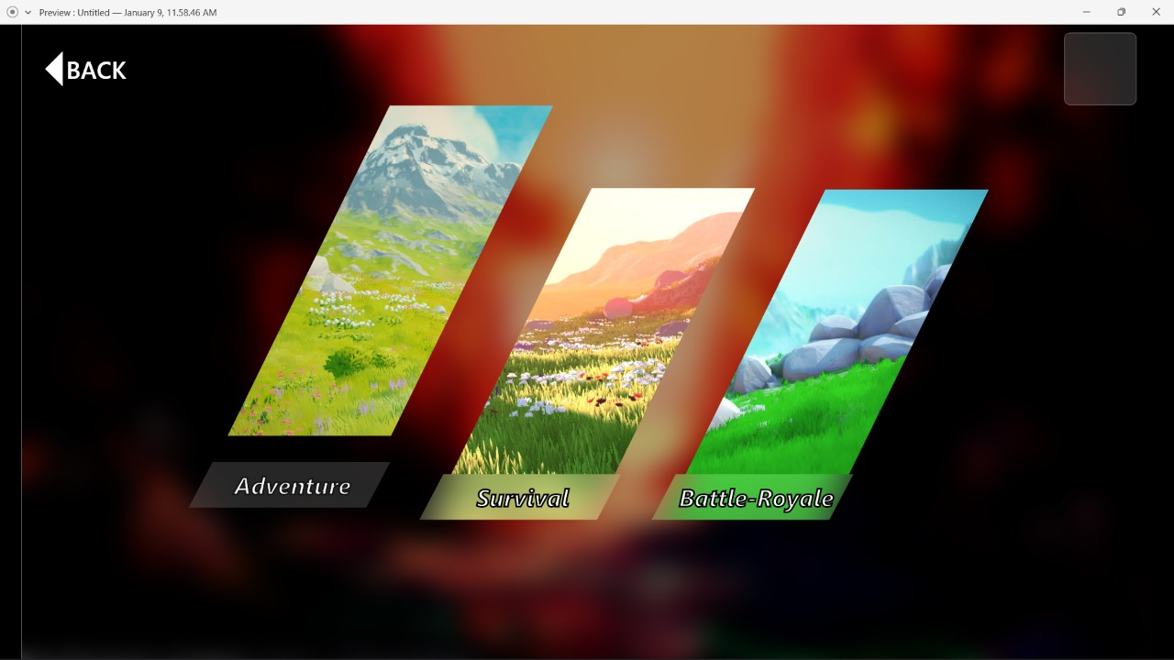

Slide 42
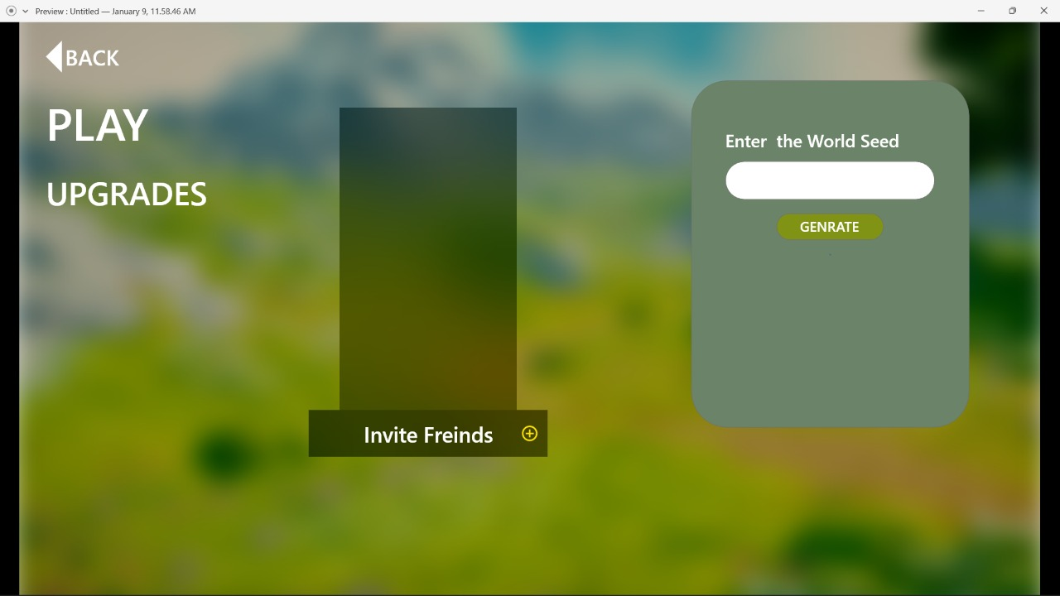

Slide 43
Networking[Rooms, Chat, VoIP]
Screen-shots

Slide 44
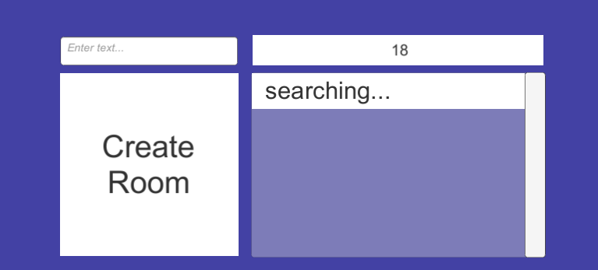
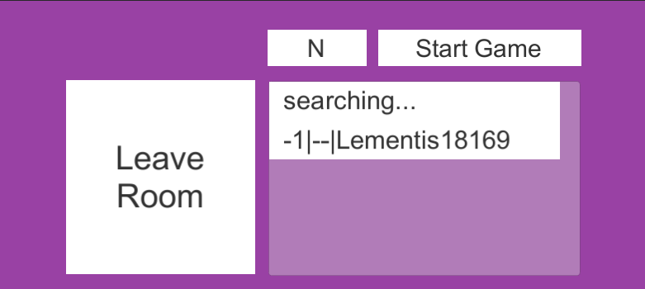

Slide 45
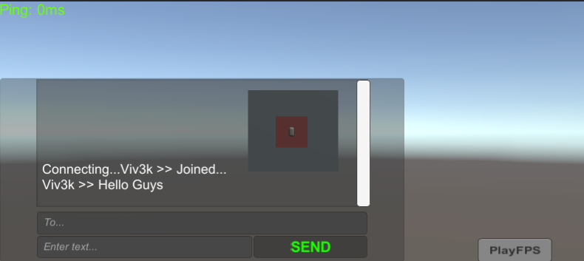

Slide 46
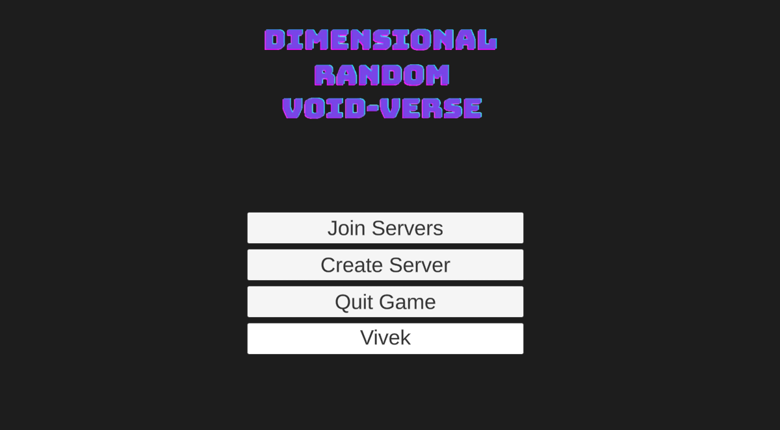

Slide 47
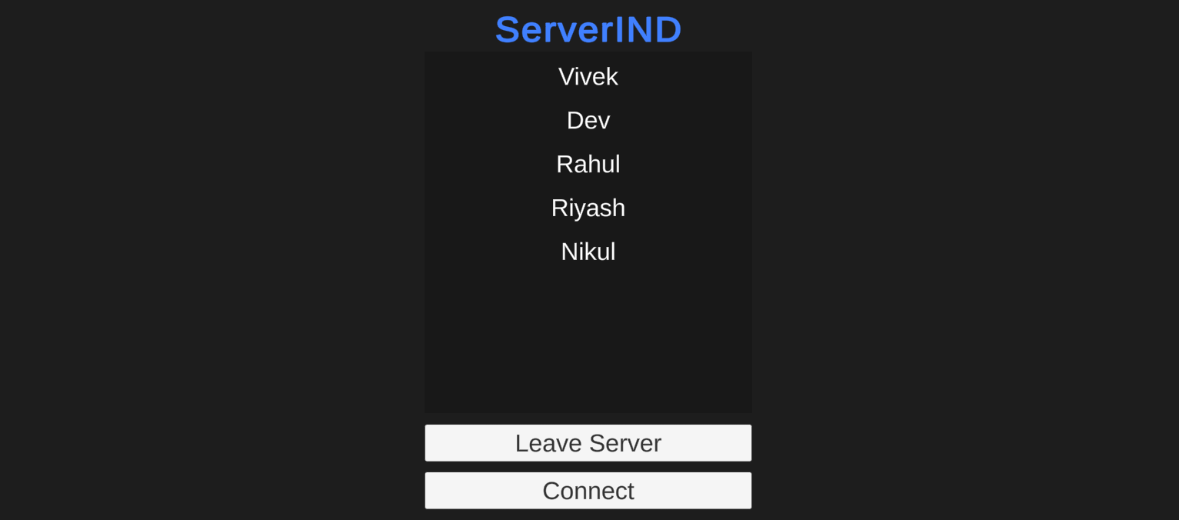

Slide 48
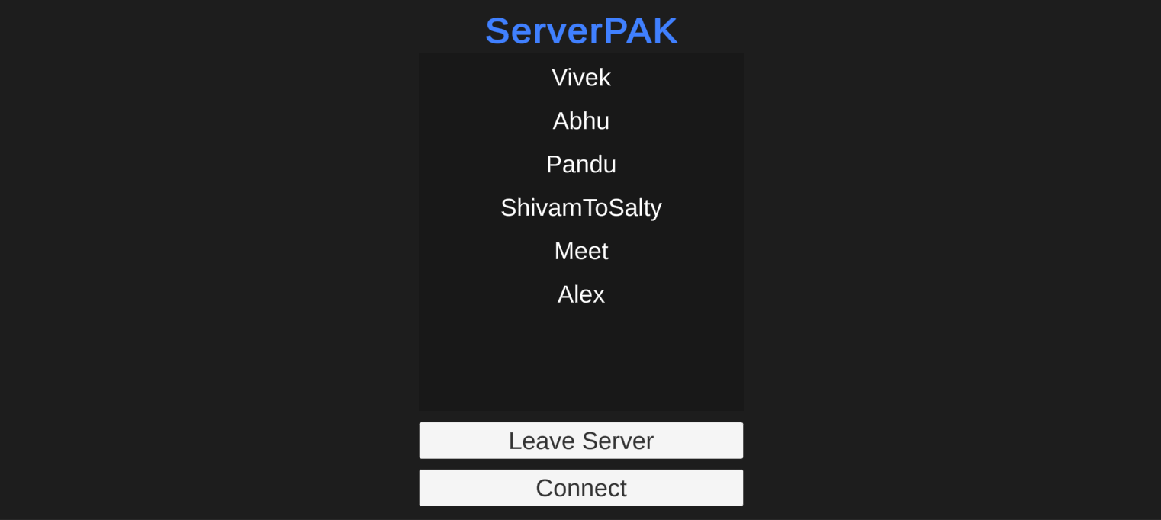

Slide 49
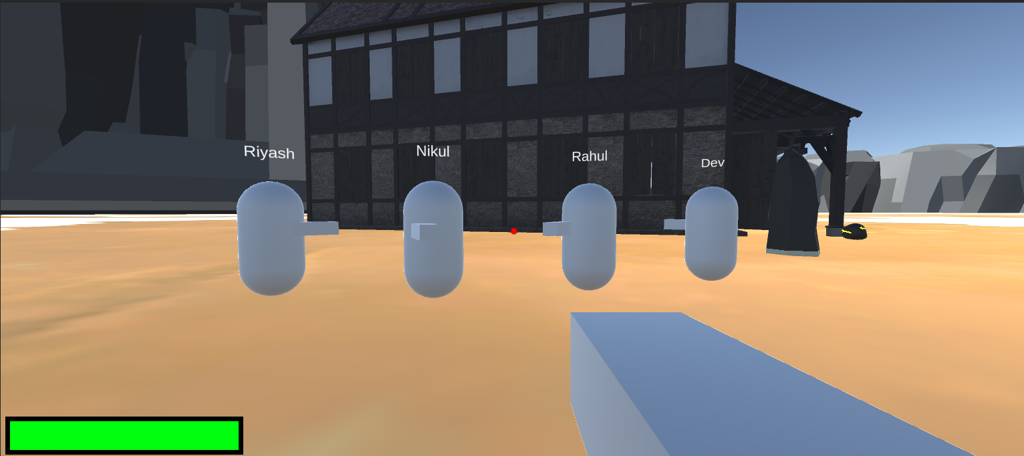

Slide 50
On Going Development Pics
Screen-shots

Slide 51
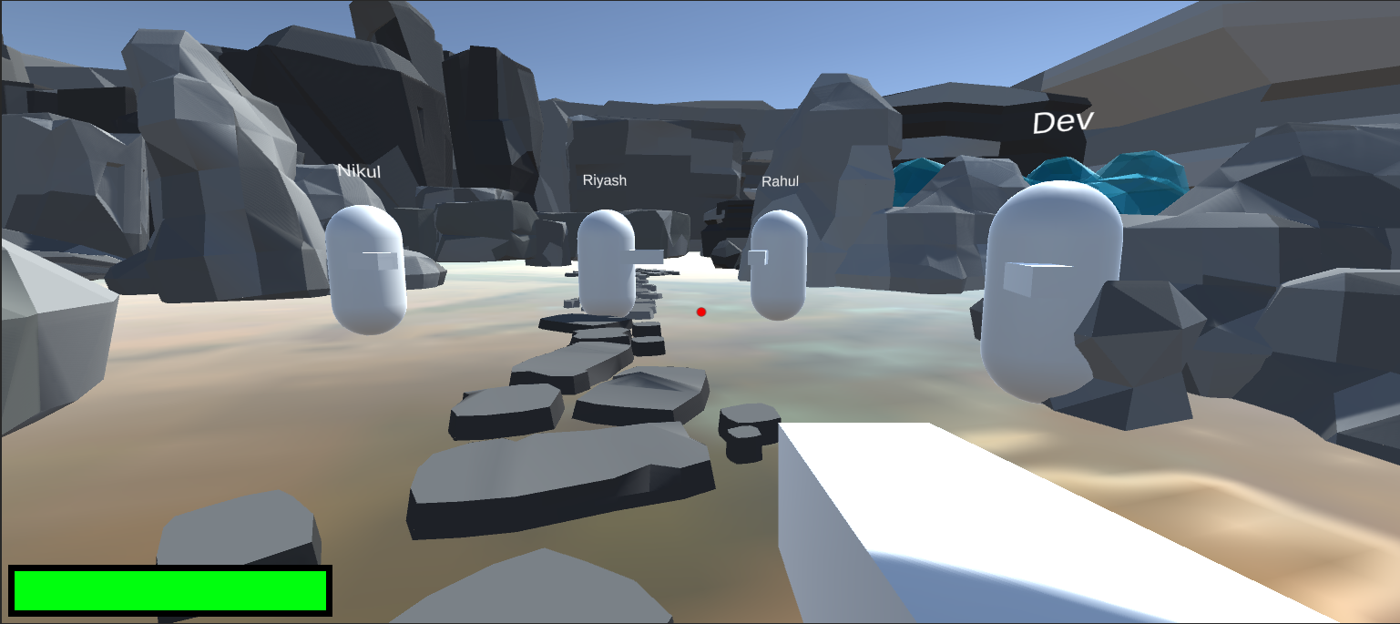

Slide 52
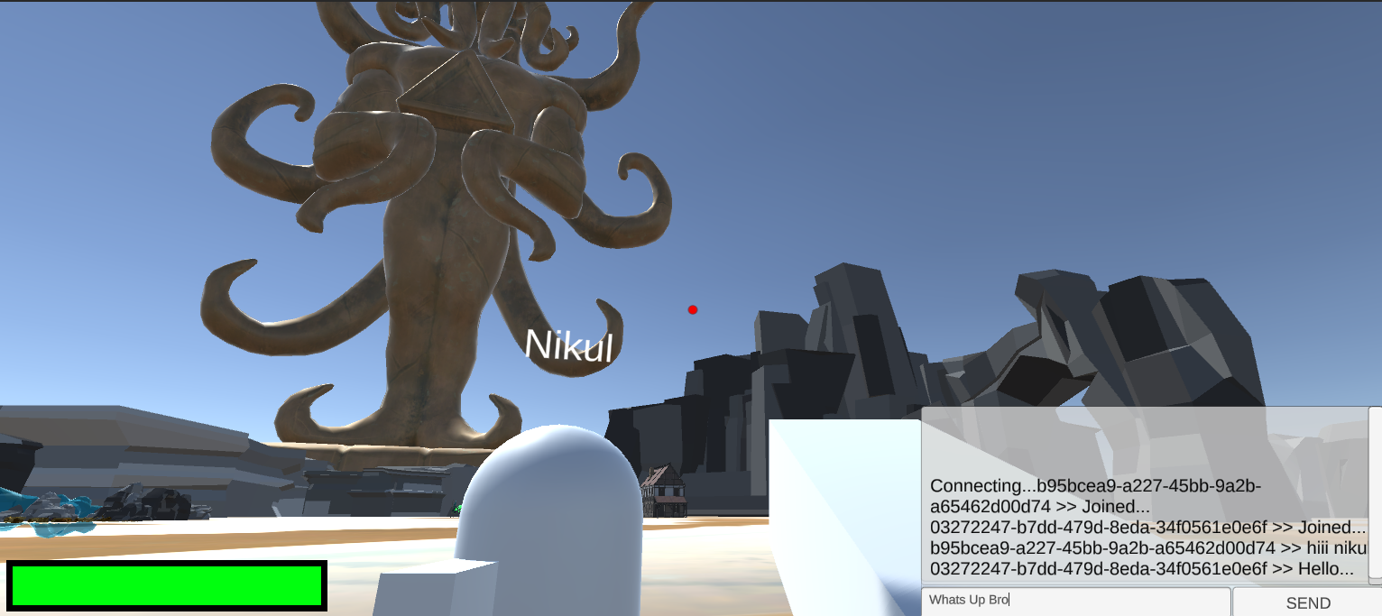

Slide 53
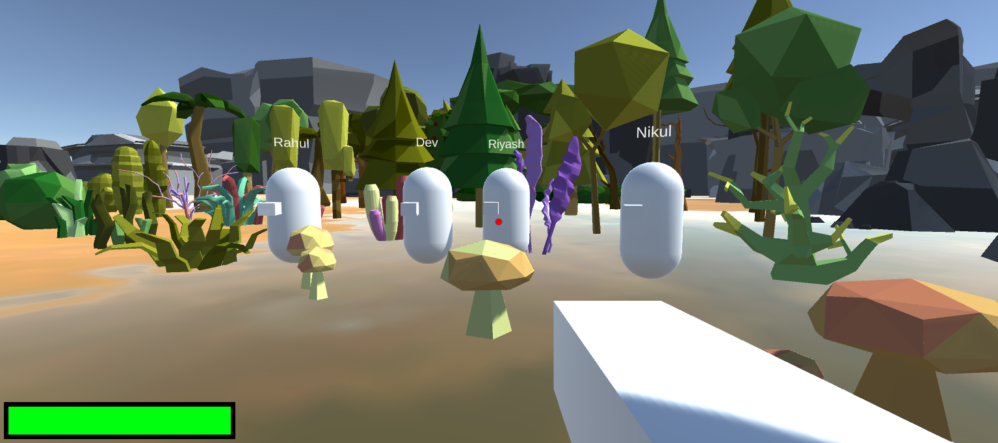

Slide 54
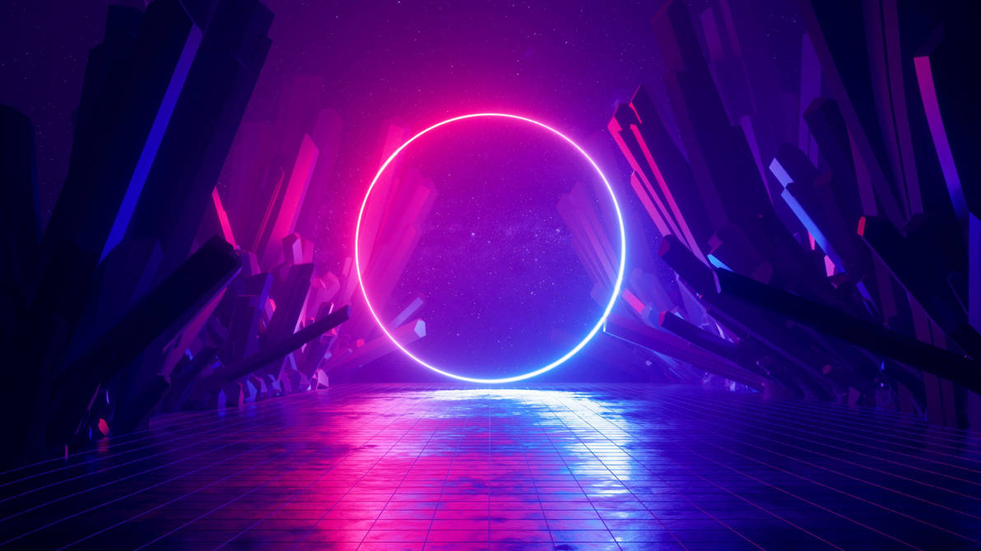
GAME
ON
GAME
ON

